Slide 1
Topic: Database Encryption
ITMS 528 Database Security
Hong Zhang

Slide 2
What is covered
Database Encryption Basics:
Definition
Classification
Different Factors for Database Encryption
Encryption Granularity
Encryption Algorithm
Encryption Key
Applications
Oracle
Microsoft SQL Server
MySQL
Third-Party Vendors
Data Encryption’s limitations

Slide 3


Importance for Encryption
In 2012, Dangdang.com -- one of China's biggest e-commerce websites was hacked
More than 12 million users’ information was leaked and hackers withdrew their accounts’ e-money
Notes:
To achieve a safe database environment, Database security emphasizes three main properties: confidentiality, integrity and availability. The best way to protect the data is combining these three properties together.

Slide 4

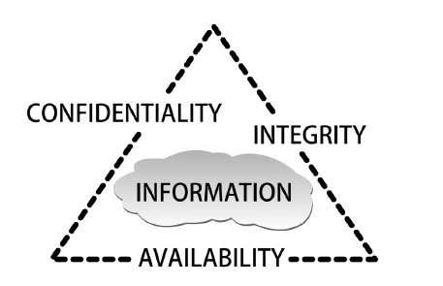
Importance for Encryption
A Security Mode for Database Security:
C.I.A. triangle
Notes:
To achieve a safe database environment, Database security emphasizes three main properties: confidentiality, integrity and availability. The best way to protect the data is combining these three properties together.

Slide 5
Importance for Encryption
Main Methods To Protect Data:
Access Controls
Encryption
Notes:
access controls to gate that should or should not be allowed access to the database, and encryption to protect data at rest.

Slide 6
Importance for Encryption
Access Controls
Encryption
A Security Mode for Database Security:
C.I.A. triangle
Notes:
Confidentiality connects with access controls. Integrity points to encryption. Availability means these two methods should not hinder users’ operation.

Slide 7
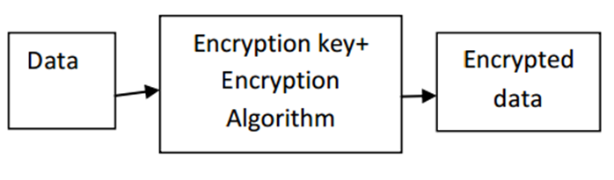
Definition
Encryption: the transformation of data by using sophisticated algorithms in an attempt to make the data unrecognizable
Basic Encryption Processes
Notes:
Data are encrypted using encryption keys and encryption algorithms.

Slide 8
Definition
Database Encryption: Use encryption techniques to transform a plain text database into a whole or partially encrypted database, thus making it unreadable to anyone except those users who hold the encryption keys.
Notes:
Data are encrypted using encryption keys and encryption algorithms.

Slide 9
Classification
Database Encryption
Within Database
Outside Database
Notes:
While performing database encryption, we can encrypt data inside or outside the database.

Slide 10
Classification
DATABASE APPLICATION
DBMS
Encryption Module
Database
Unencrypted
Data
Encrypted
Data
Encryption
Key
Encryption Within Database

Slide 11
Classification
Performer: DBMS
Advantages:
less impact on application environment
can protect against a wide range of threats
Disadvantages:
Encryption keys usually store in the same database
Choice for encryption algorithm is limit
Encryption Within Database

Slide 12
Classification
DATABASE APPLICATION
DBMS
Encryption
Server
(Encryption Key)
Database
Unencrypted
Data
Encrypted
Data
Encryption Outside Database

Slide 13
Classification
Performer: Specialized Encryption Server
Advantages:
Encryption keys and data are separated
Options for encryption algorithm are many
Disadvantages:
Functions of DBMS will be limited after encryption, such as index.
Encryption Outside Database

Slide 14
Encryption Factors
Different Factors affect Database Encryption:
• Encryption Granularity
• Encryption Algorithm
• Encryption Key

Slide 15
Encryption granularity
Page/block granularity
Each page is encrypted separately and might contain one or multiple records.
(2) Attribute/column granularity
Encrypt only certain sensitive attributes in a table
(3) Record/row granularity
Allows one to retrieve individual rows without decrypting the whole table.
(4) Field granularity. (suggest to use)
It is the smallest achievable granularity based on the field of a record.

Slide 16
Encryption Algorithm
Encryption Algorithm:
a mathematical procedure
Basic Encryption Processes

Slide 17
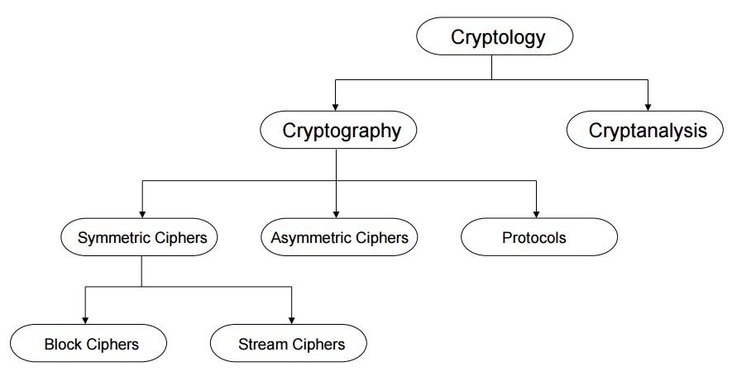
Encryption Algorithm
RSA
DES
3DES
AES
Classification in the Field of Cryptology

Slide 18
Standard Symmetric Algorithms
Algorithm | Type | Key | Strength | DBMS
DES | Block | 56 | Weak | Oracle, MS SQL
3DES | Block | 128 | Acceptable | Oracle, MS SQL
AES-192 | Block | 192 | Strong | Oracle DBMS Crypto, MS SQL, MySQL
AES-256 | Block | 256 | Strong | Oracle DBMS Crypto, MS SQL, MySQL

Slide 19
Encryption Algorithm
Data Encryption Standard (DES)
Encrypts blocks of size 64 bit
Standardized in 1977 by American National Standards Institute
Most popular block cipher for most of the last 30 years.
Nowadays considered insecure due to the small key length of 56 bit
But: 3DES yields very secure cipher, still widely used today
Replaced by the Advanced Encryption Standard (AES) in 2000

Slide 20
Encryption Algorithm
The encryption algorithm of 3DES is:
ciphertext = E_{K3}(D_{K2}(E_{K1}(plaintext)))
Decryption is the reverse:
plaintext = D_{K1}(E_{K2}(D_{K3}(ciphertext)))
3DES extends the effective key length of DES to 112 bites
DES has 2⁵⁶ combinations and 3DES is 2¹¹² or 2¹⁶⁸

Slide 21
Encryption Algorithm
Advanced Encryption Standard (AES)
the most widely used symmetric cipher today
Block cipher with 128-bit block size
Three supported key lengths: 128, 192 and 256 bit
128 bits is quite strong
Assuming one can break DES in 1 second (trying 2⁵⁶ keys in one second), then, trying 2¹²⁸ keys requires 149 Trillion years
Efficiency in software and hardware

Slide 22
Encryption Algorithm
RSA Cryptosystem
the most widely use asymmetric cryptosystem
RSA is mainly used for two applications
1. Transport of (i.e., symmetric) keys
2. Digital signatures
Even though conceptually simple, due to the use of very long numbers, RSA is orders of magnitude slower than symmetric schemes, e.g., DES, AES

Slide 23
Encryption Key
Symmetric key
Asymmetric key
Basic Encryption Processes

Slide 24
Encryption Key
Encryption Algorithms: Asymmetric (left) and Symmetric (right)

Slide 25
Key Management
Cryptographic Access Control
Encrypting objects from different security groups
using different keys ensures that a user who owns
a specific key can decrypt only those objects within
his security group
Secure Key Storage
Separate the keys and data residing in the database
a. HSM Approach
b. Security Server Approach

Slide 26
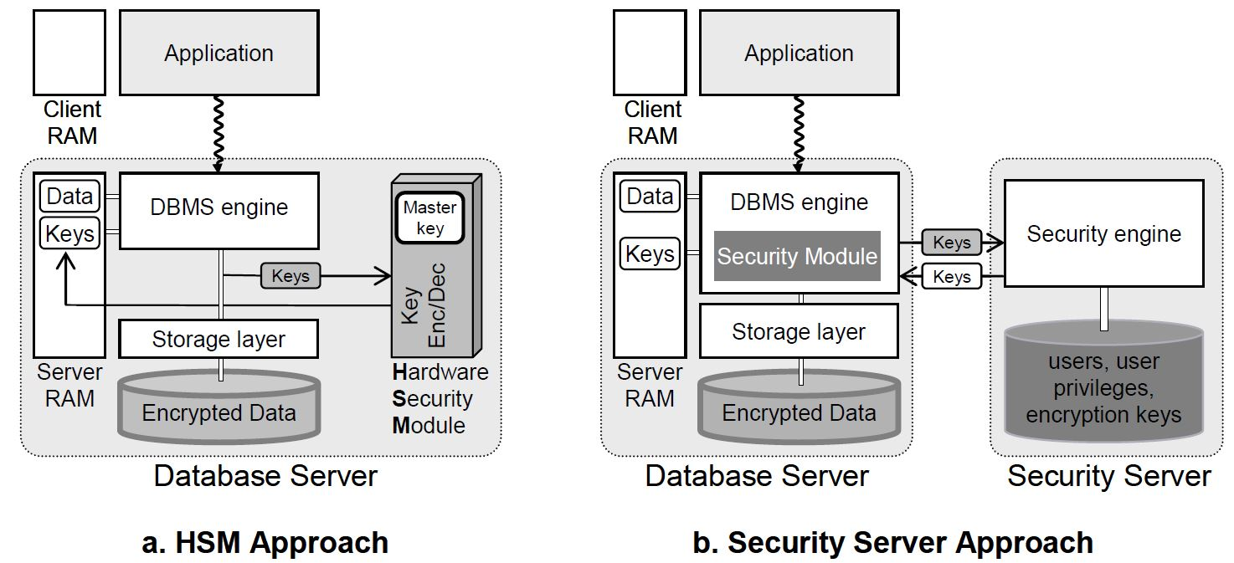
Key Management
Key Management Approaches

Slide 27
Application
Data Encryption within Database (Native Database Encryption)
Oracle
Microsoft SQL Server
MySQL
Data Encryption outside Database (Third-Party Vendors’ Encryption)

Slide 28
Application
Oracle
Dbms_Obfuscation_Toolkit Package
Dbms_Crypto Package
Transparent Data Encryption (TDE)

Slide 29
Oracle
Dbms_Obfuscation_Toolkit Package
Introduced in Oracle 8i
Uses DES algorithm
Now often uses 3DES to do encryption

Slide 30
Oracle
DBMS_OBFUSCATION_TOOLKIT.DES3Encrypt(
input_string IN VARCHAR2,
key_string IN VARCHAR2,
which IN PLS_INTEGER DEFAULT TwoKeyMode
iv_string IN VARCHAR2 DEFAULT NULL) RETURN VARCHAR2;
DBMS_OBFUSCATION_TOOLKIT.DES3DECRYPT(
input_string IN VARCHAR2,
key_string IN VARCHAR2,
which IN PLS_INTEGER DEFAULT TwoKeyMode
iv_string IN VARCHAR2 DEFAULT NULL) RETURN VARCHAR2;
Dbms_Obfuscation_Toolkit Syntax

Slide 31
Oracle
Dbms_Crypto Package
Released in Oracle 10.1
Supports AES
Provides automatic padding
Different options for block chaining
Support for CLOB and BLOB
Will deprecate dbms_obfuscation_toolkit

Slide 32
Oracle
Feature | Dbms_Crypto Supported Functionality
Cryptographic algorithms | DES, 3DES, AES, RC4,sDES_2KEY
Padding forms | PKCS5, zeroes
Block cipher chaining modes | CBC, CFB, ECB, OFB
Cryptographic hash algorithms | SHA-1, SHA-2, MD4, MD5, HASH_SH256, HASH_SH384, HASH_SH512
Keyed hash(MAC) algorithms | HMAC_MD5, HMAC_SH1, HMAC_SH256, HMAC_SH384, HMAC_SH512
Cryptographic pseudo-random number generator | RAW, NUMBER, BINARY_INTEGER
Database types | RAW, CLOB, BLOB
Dbms_Crypto Package Feature Summary

Slide 33
Oracle
Before using Dbms_Crypto, VARCHAR2 needs to use the UTL_I18N.STRING_TO_RAW function to convert to RAW type.
Convert VARCHAR2 to RAW:
1. Convert VARCHAR2 in the current database character set to VARCHAR2 in the AL32UTF8 database character.
2. Convert VARCHAR2 in the AL32UTF8 database character set to RAW.
UTL_I18N.STRING_TO_RAW (string, 'AL32UTF8');
Convert RAW to VARCHAR2:
1. Convert RAW to VARCHAR2 in the AL32UTF8 database character set.
2. Convert VARCHAR2 in the AL32UTF8 database character set to VARCHAR2 in the database character set you wish to use.
UTL_I18N.RAW_TO_CHAR (data, 'AL32UTF8');
Dbms_Crypto Package Conversion Rules

Slide 34
Dbms_Crypto Package Subprograms
Subprogram | Description
Decrypt Function | Decrypts RAW data using a stream or block cipher with a user supplied key and optional IV (initialization vector)
Decrypt Procedures | Decrypts LOB data using a stream or block cipher with a user supplied key and optional IV
Encrypt Function | Encrypts RAW data using a stream or block cipher with a user supplied key and optional IV
Encrypt Procedures | Encrypts LOB data using a stream or block cipher with a user supplied key and optional IV
Hash Function | Applies one of the supported cryptographic hash algorithms (MD4, MD5, or SHA-1) to data
MAC function | Applies Message Authentication Code algorithms (MD5 or SHA-1) to data to provide keyed message protection
RandomBytes Function | Returns a RAW value containing a cryptographically secure pseudo-random sequence of bytes, and can be used to generate random material for encryption keys
RandomInteger Function | Returns a random BINARY_INTEGER
RandomNumber Function | Returns a random 128-bit integer of the NUMBER datatype

Slide 35
Oracle
create or replace function get_enc_val (
p_in in varchar2,
p_key in raw)
return raw is
l_enc_val raw (2000);
l_mod number := dbms_crypto.ENCRYPT_AES128
+ dbms_crypto.CHAIN_CBC
+ dbms_crypto.PAD_PKCS5;
begin
l_enc_val := dbms_crypto.encrypt(
UTL_I18N.STRING_TO_RAW
(p_in, 'AL32UTF8'),
l_mod,
p_key);
return l_enc_val;
end;
Encryption Function using Dbms_Crypto Package

Slide 36
Oracle
create or replace function get_dec_val(
p_in in raw,
p_key in raw)
return varchar2
is
l_ret varchar2 (2000);
l_dec_val raw (2000);
l_mod number := dbms_crypto.ENCRYPT_AES128
+ dbms_crypto.CHAIN_CBC
+ dbms_crypto.PAD_PKCS5;
begin
l_dec_val := dbms_crypto.decrypt(
p_in,
l_mod,
p_key);
l_ret:= UTL_I18N.RAW_TO_CHAR(l_dec_val, 'AL32UTF8');
return l_ret;
end;
Decryption Function using Dbms_Crypto Package

Slide 37
Transparent Data Encryption(TDE)
Oracle
Introduced in Oracle 10.2
– column encryption
Enhanced in Oracle 11.1
- tablespace encryption

Slide 38
Oracle
Encryption algorithms | Hashing Algorithms (optional)
AES Key length: 128, 192, 256 bits | SHA-1 Digest length: 160 bits
3DES Key length: 168 bits
Standard Encryption Algorithms Used By TDE

Slide 39
How is TDE Implemented?
Oracle
1 Setup Wallet and Master Key
2 Identify columns with sensitive data
3 Review constraints
4 Encrypt existing and new data

Slide 40
Oracle
Managing and rotating TDE master keys
using Oracle Enterprise Manager

Slide 41
Oracle
Two more part must be encrypted:
Set a TNS Listener password and encrypt to prevent unauthorized administration
By default, the TNS Listener has no password set
Enable database link login encryption.
The SYS.LINK$ table contains credentials for remote database servers.
Tips

Slide 42
Microsoft SQL Server
In SQL Server 2000 or older version, there is no encryption package or function.
Now, there are two types:
Column-level Encryption (SQL Server 2005)
SQL Server TDE (SQL Server 2008)

Slide 43
Microsoft SQL Server
SQL Server Layer | ANSI X9.17 Layer | Description
SMK | Server Master key | The SMK is the top-level key used to encrypt the DMK. The SMK is encrypted by the Windows DPAPI.
DMK | Database Master key | The DMK is a symmetric key that’s used to encrypt a symmetric key, asymmetric key, and certificates. Only one DMK can be defined for each database.
Symmetric keys, asymmetric keys, and certificates | Database encrypting key | Symmetric keys, asymmetric keys, and certificates are used to encrypt data.
SQL Server and ANSI X9.17 Encryption Key Layers

Slide 44
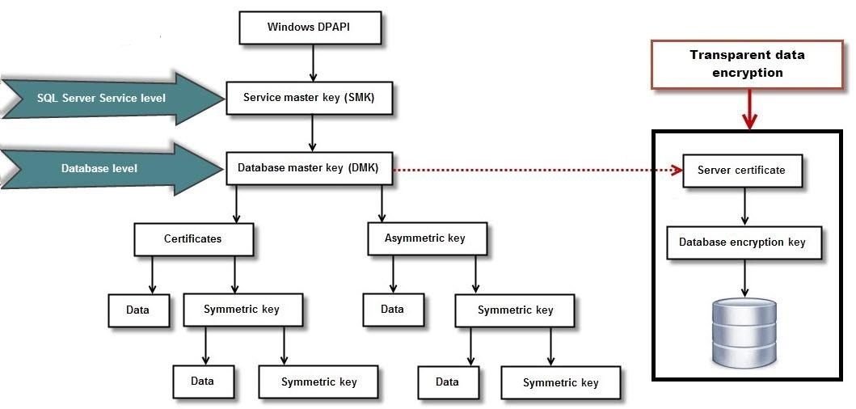
Microsoft SQL Server
Encryption Key Hierarchy in SQL Server 2008 and Later

Slide 45
Microsoft SQL Server
EncryptByCert() and DecryptByCert(), which use the public key of a certificate to encrypt and decrypt data
EncryptByAsymkey() and DecryptByAsymkey (), which use an asymmetric key to encrypt and decrypt data
EncryptByKey() and DecryptByKey (), which use a symmetric key to encrypt and decrypt data
EncryptByPassphrase() and DecryptByPassphrase(),which uses a passphrase to generate a symmetric key to encrypt and decrypt data
Decryptbykeyautoasymkey(), which decrypts data by using a symmetric key that's automatically decrypted with an asymmetric key
Decryptbykeyautocert(), which decrypts data by using a symmetric key that's automatically decrypted with a certificate
Column-level Encryption

Slide 46
Microsoft SQL Server
SQL Server TDE encrypts the data before it's written to disk and decrypts it before it is retrieved. This process is performed at the SQL Server Service layer.
With TED, SQL Server encrypts a database using its database encryption key. This asymmetric key is stored in the database boot record. The database encryption key is encrypted using the server certificate, which is encrypted using the Database Master Key of the master database. The master database's Database Master Key is encrypted using Server Master Key. The Server Master Key is an asymmetric key that's encrypted by the Windows DPAPI. The Server Master Key is automatically created the first time you encrypt something and is tied to the SQL Server Service account.
SQL Server TDE

Slide 47
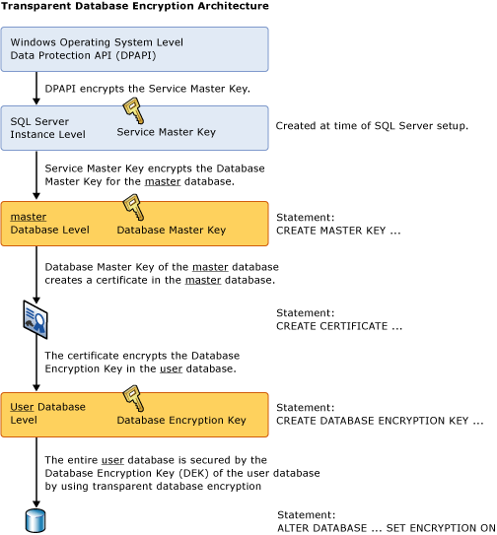
Microsoft SQL Server

Slide 48
Microsoft SQL Server
Steps for using TDE:
Create a master key
Create or obtain a certificate protected by the master key
Create a database encryption key and protect it by the certificate
Set the database to use encryption
SQL Server TDE

Slide 49
Microsoft SQL Server
USE master;
GO
CREATE MASTER KEY ENCRYPTION BY PASSWORD = '<UseStrongPasswordHere>';
go
CREATE CERTIFICATE MyServerCert WITH SUBJECT = 'My DEK Certificate';
go
USE AdventureWorks2012;
GO
CREATE DATABASE ENCRYPTION KEY
WITH ALGORITHM = AES_128
ENCRYPTION BY SERVER CERTIFICATE MyServerCert;
GO
ALTER DATABASE AdventureWorks2012
SET ENCRYPTION ON;
GO
SQL Server TDE: an example

Slide 50
MySQL
Name | Description
Aes_Decrypt() | Decrypt using AES
Aes_Encrypt() | Encrypt using AES
Compress() | Return result as a binary string
Decode() | Decodes a string encrypted using ENCODE()
Des_Decrypt() | Decrypt a string (not available in MySQL 5.7.6)
Des_Encrypt() | Encrypt a string (not available in MySQL 5.7.6)
Encode() | Encode a string
Encrypt() | Encrypt a string (not available in MySQL 5.7.6)
Md5() | Calculate MD5 checksum
Old_Password() | Return the value of the pre-4.1 implementation of PASSWORD
Password() | Calculate and return a password string
Random_Bytes() | Return a random byte vector
Sha1(), Sha() | Calculate an SHA-1 160-bit checksum
Sha2() | Calculate an SHA-2 checksum
Uncompress() | Uncompress a string compressed
Uncompressed_Length() | Return the length of a string before compression
Validate_Password_Strength() | Determine strength of password
MySQL Encryption Functions

Slide 51
Third-Party Vendors’ Encryption
Data protection across platforms
protect data within or outside the database
Separation of duties
separation of duties between the system, database and security administrators
Separation of functionality
database do not need for encryption and decryption

Slide 52
Data Encryption’s limitations
Encryption Does Not Solve Access Control Problems
Encryption Does Not Protect Against a Malicious DBA
Encrypting Everything Does Not Make Data Secure

Slide 53
Conclusion
Encryption is the process of obfuscating data by the use of a key or password. This can make the data useless without the corresponding decryption key or password. It is one basic and important method to secure the data. However, there is no perfect application in the world. Each one has its own advantages and disadvantages. When users think about the secure plan, it should be a combination which includes every field.

